Slide 1
Environmental Station Monitoring System
Made with ThingsBoard, RIOT OS and LoRaWAN

Slide 2
Main idea
We want to monitor 2 environmental stations, each with 5 sensors:
- Temperaure (- 50 … 50 °C)
- Humidity (0 … 100 %)
- Wind Direction (0 … 360 Degrees)
- Wind Intensity (0 … 100 m/s)
- Rain Height (0 … 50 mm/h)
We use the LoRaWAN network to provide communication between the stations and our
application.
To do this we’ll need a LoRaWAN network server and a bridge to
forward data to the dashboard where we’ll visualize it.

Slide 3


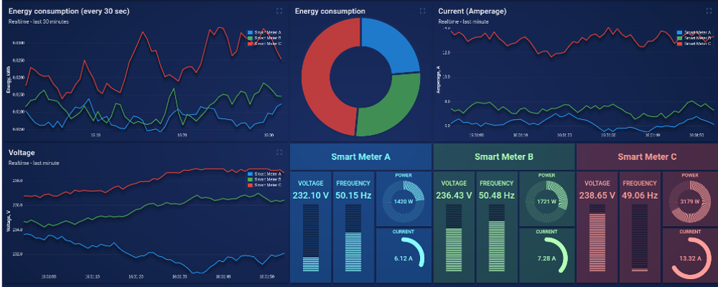
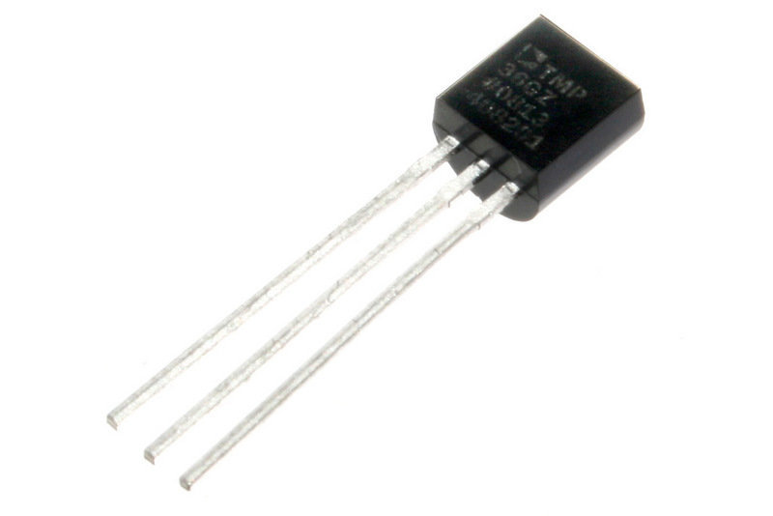

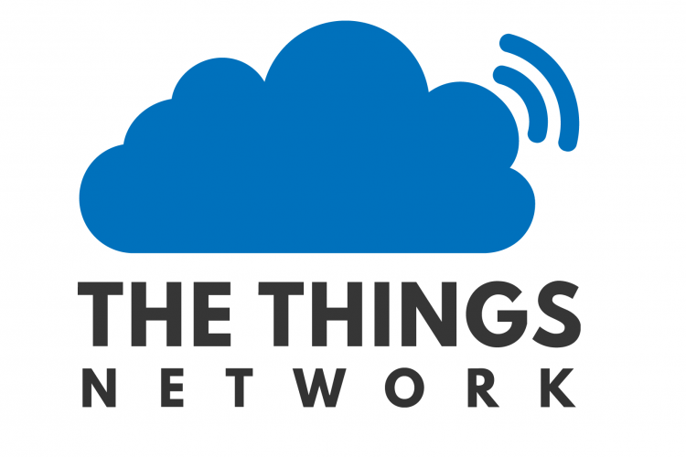
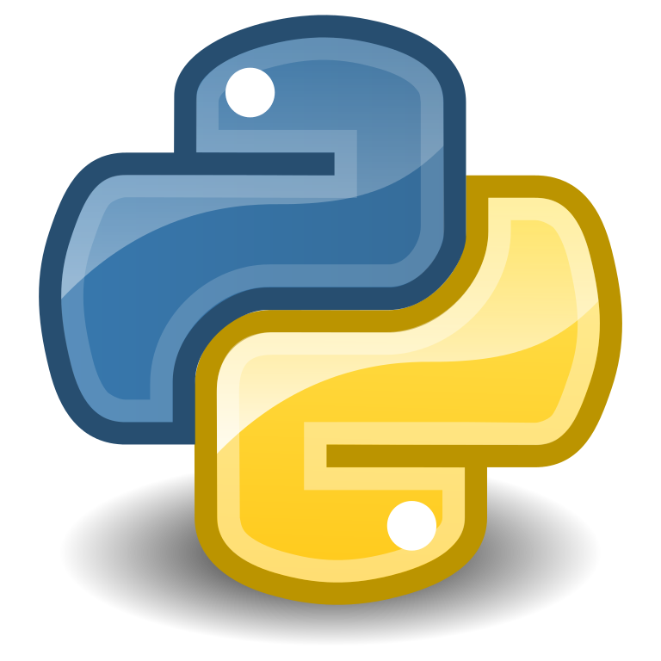
Architecture
ThingsBoard Dashboard
Environmental Station 1
ThingsBoard IoT Platform
LoRaWAN
MQTT Channel
Environmental Station 2
MQTT Channel
Python Bridge
IoT-Lab testbed

Slide 4
Implementation
The sensors and environmental stations are simulated by a simple program done with RIOT OS. This is deployed on two ST B-L072Z-LRWAN1 IoT-Lab nodes, one for each station.
The data is sent through the LoRaWAN network to The Things Network server. A Python bridge is subscribed to it: the bridge receives data representing the sensors’ values, it puts the data in the appropriate format and then it forwards it to ThingsBoard. All of this is done through MQTT messages.
ThingsBoard IoT platform collects data through the MQTT channel (MQTT broker integrated in the platform) and shows it on its dashboard, which is public so that anyone could check it out.

Slide 5
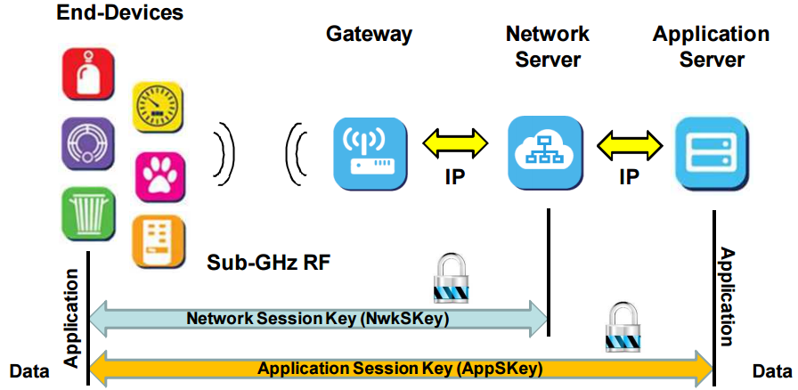
Technology: LoRaWAN
LoRaWAN is a Low Power Wide Area Network protocol. It was designed to connect
‘things’ in regional or global networks. It’s focus is on:
- saving battery;
- bi-directional communication;
- security;
- mobility and localization.
The architecture is the following:

Slide 6
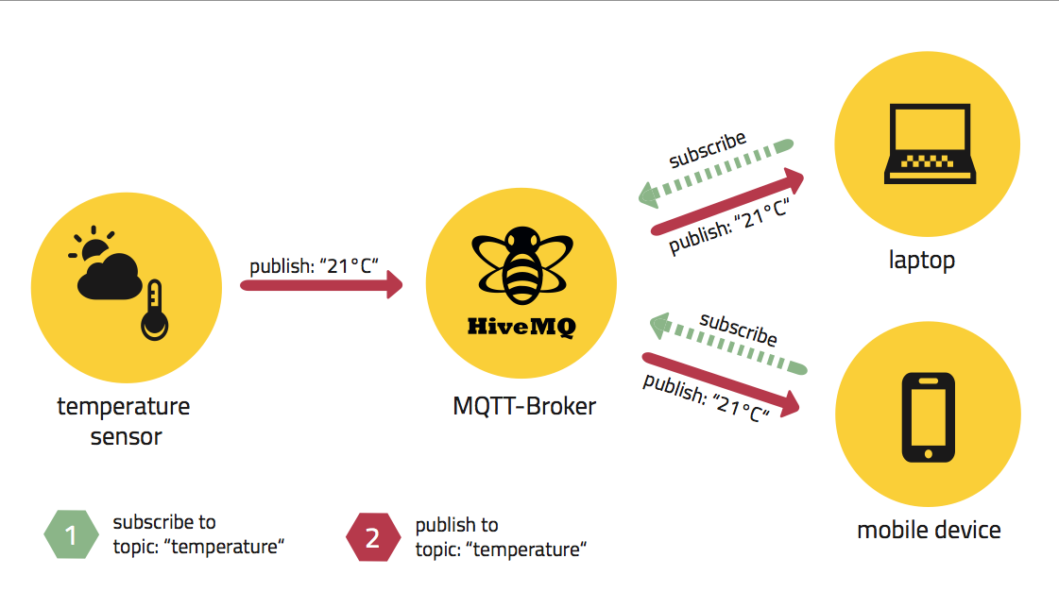
Technology: MQTT Protocol
MQTT is a machine-to-machine connectivity protocol, designed to be lightweight
and work well even in situations where little resources are provided.
Because of this, it’s ideal for sensor communication.
It’s based on the publish subscriber paradigm

Slide 7

Technology: RIOT OS
RIOT OS is an open source operating
system designed for the Internet of
Things. Supports most low power devices and microcontroller architectures (32-bit, 16-bit and 8- bit).
It’s programmable in C and C++, uses wide spread tools such as gcc and valgrind, and it’s compliant with POSIX.
It supports most IoT standards and it’s resource friendly. When a program it’s executed usually there are two threads running: the main thread that executes the task, and the idle thread which runs when the main thread stops. The idle thread puts the device in a “sleep mode” to save energy and resources.

Slide 8

Technology: FIT IoT-Lab
FIT IoT-Lab is an open testbed: it
provides a very large scale infostructure
to test your application on a real
environment.
It offers a lot of different devices, either fixed or mobile, where you can deploy
your code.
It’s part of the FIT experimental platform, a structure for academic and industrial users to do research and experiment.

Slide 9
Technology: The Things Network
The Things Network is an open source LoRaWAN network server. It is a contributor member of the LoRa Alliance.
It provides robust end-to-end encryption and global coverage

Slide 10
Technology: ThingsBoard
ThingsBoard is an open-source IoT platform to collect, process, visualize data and manage devices.
Enables connectivity through standard IoT protocols like CoAP, HTTP, MQTT and supports cloud deployment.
The pillars of this platform are scalability, fault-tolerance and performance.

Slide 11
References
RIOT OS: http://riot-os.org/
FIT IoT-Lab: https://www.iot-lab.info/
The Things Network: https://www.thethingsnetwork.org/
ThingsBoard: https://thingsboard.io

Slide 12
Thank you for you attention!

